Slide 1
Formula SAE Suspension
Presentation 3
Parker Johnson: Suspension Design Lead
Chris Laney: Brakes Engineer
Garrett Pearson: A-Arm Engineer
Mathew Cusson: Steering Engineer
Joseph Ciao: Pushrod Assembly Engineer
Page 1

Slide 2
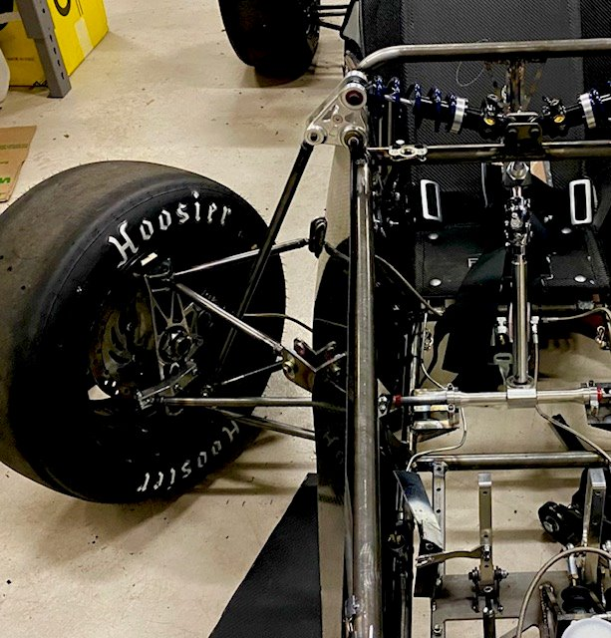
Sub-Team Description
Focus is on the vehicles overall suspension system
Design of A-arm, Brakes, Knuckles, Pushrod assembly, Steering, among other systems.
Overall goal: improvement from last year's design mostly in adjustability and overall drivability including ease of steering.
Why is this important: Suspension directly effects the car's handling, stability, and overall safety. It plays a vital role in maximizing tire contact, improving cornering speed, and ensuring driver control.
PHOTO
Fig. 1: Picture of 1st year Front Suspension System
Page 2 - Garrett

Slide 3
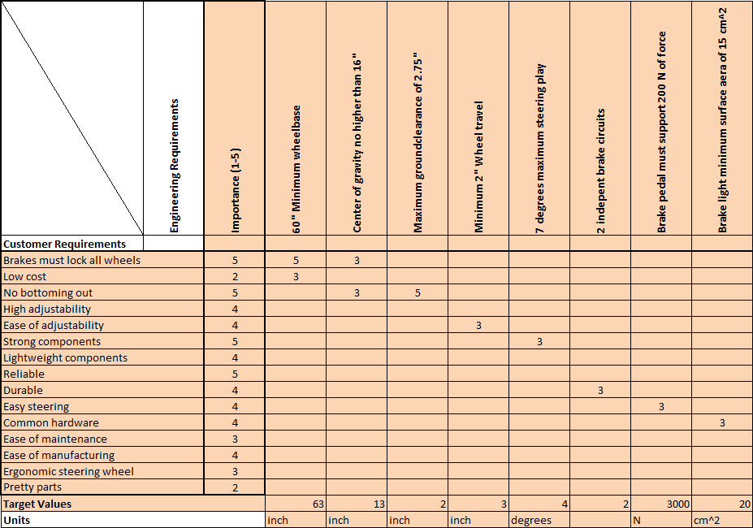
Design Requirements (QFD)
PHOTO
Page 3 - Parker
Figure 2. QFD

Slide 4
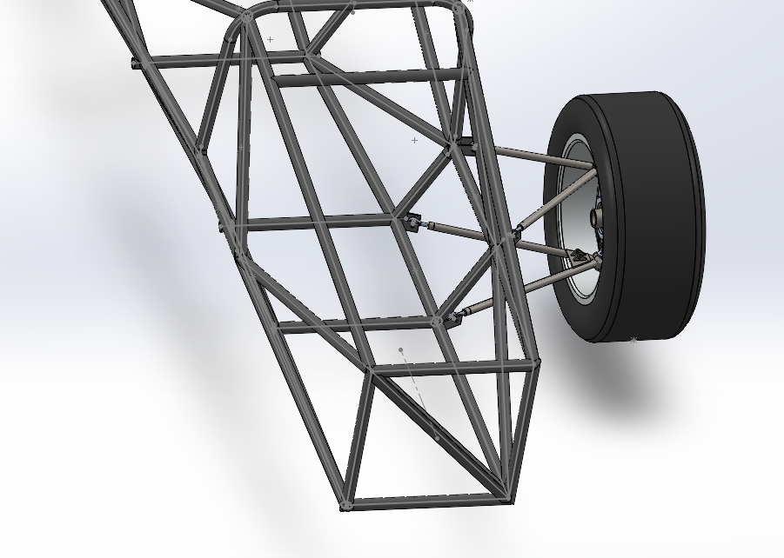
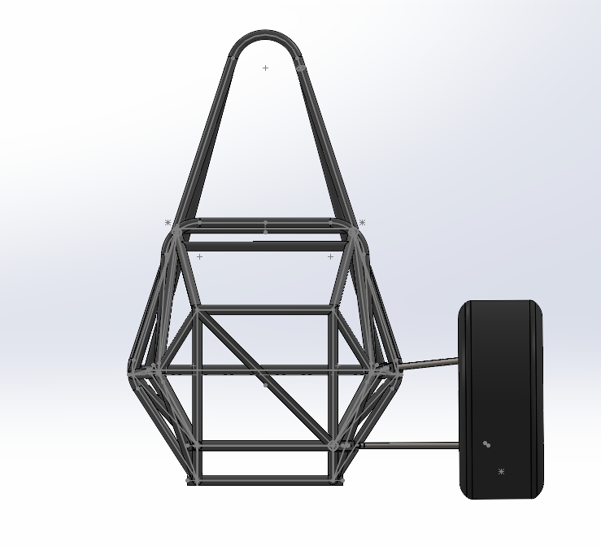
Design Description
PHOTO
The figures above and on the next page shows accurately what our suspension will look like.
Currently the A-arms and the knuckle/brakes assembly are shown, however this will be very useful for a motion study and making sure no moving parts collide throughout its 3” range of travel.
Page 3 - Parker

Slide 5
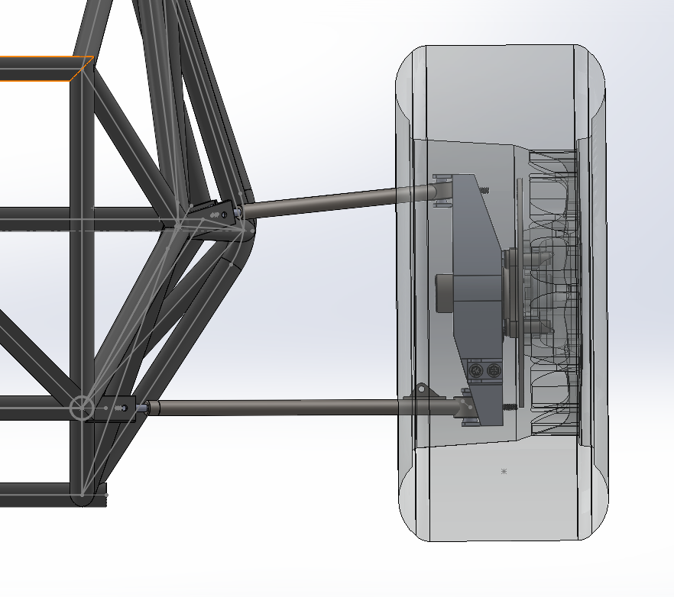
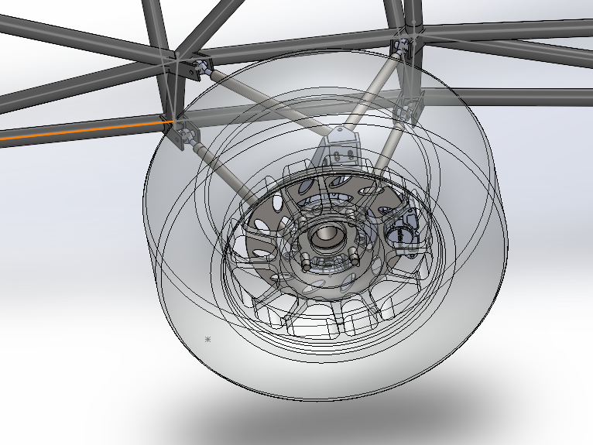
Design Description
PHOTO
The above figures show that no parts interfere with the tire/wheel selection our team is going with for our design. (OZ racing 13” and 20.5” Hoosier Tires)
Page 3 - Parker

Slide 6
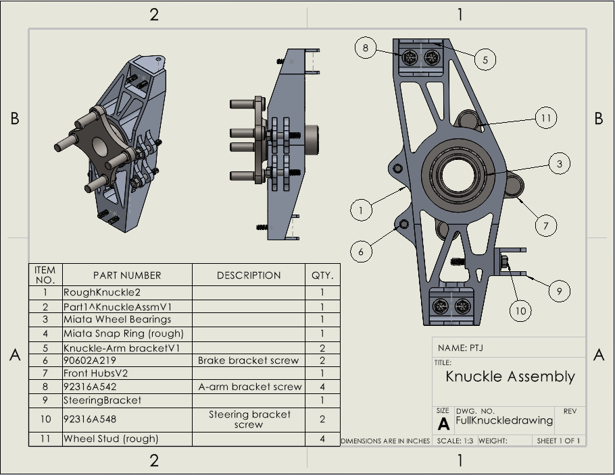
Design Description – Knuckles
The Knuckle connects the wheel to all other suspension components such as the A-arms, brakes, and steering
Defines steering geometry
Must be strong enough to withstand many forces simultaneously
LL
Page 4 - Parker
Figure 3. Knuckle Assembly Drawing

Slide 7
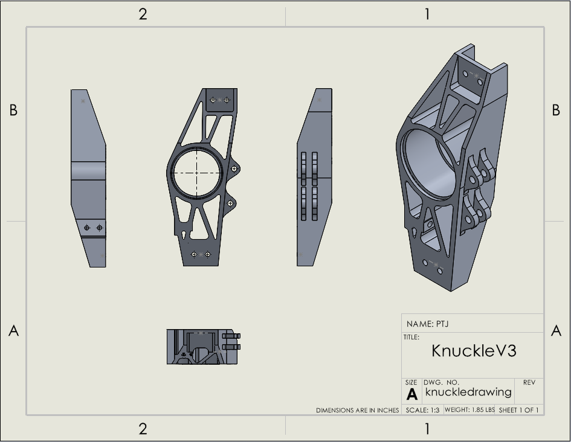
Design Description – Knuckles
General steering knuckle design
3 step manufacturing process
Features a press fit tolerance for the wheel bearing, and snap ring groove
Aluminum for easy machinability and weight
LL
Page 5 - Parker
Figure 4. Knuckle parts drawing

Slide 8
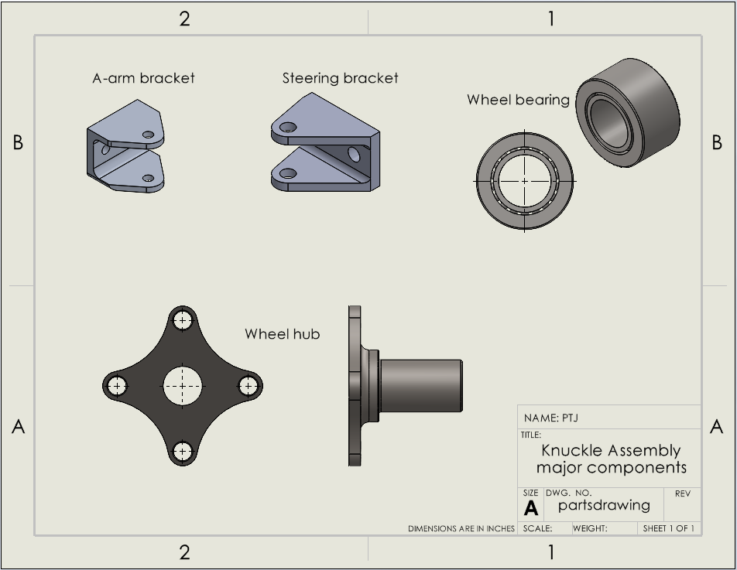
Design Description – Knuckles
LL
Figure 5. Knuckle parts part 2
Page 6 - Parker

Slide 9
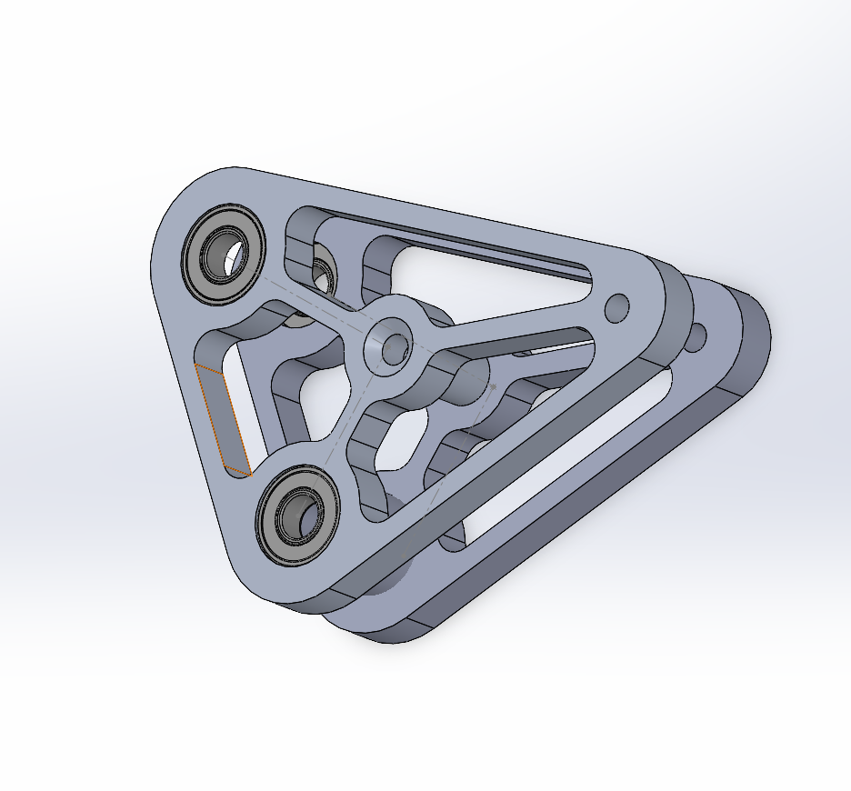
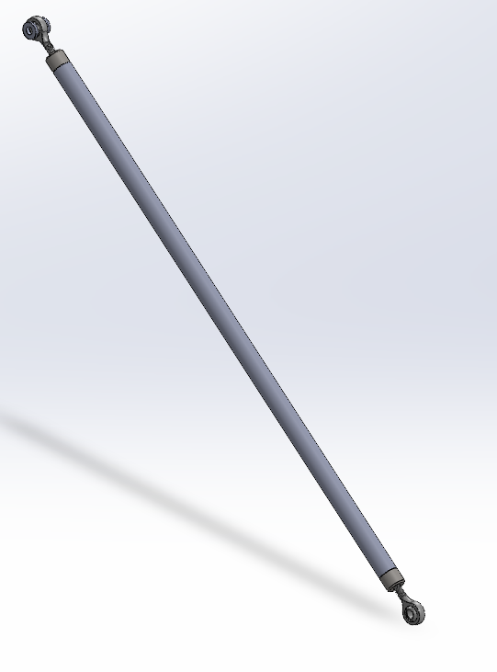
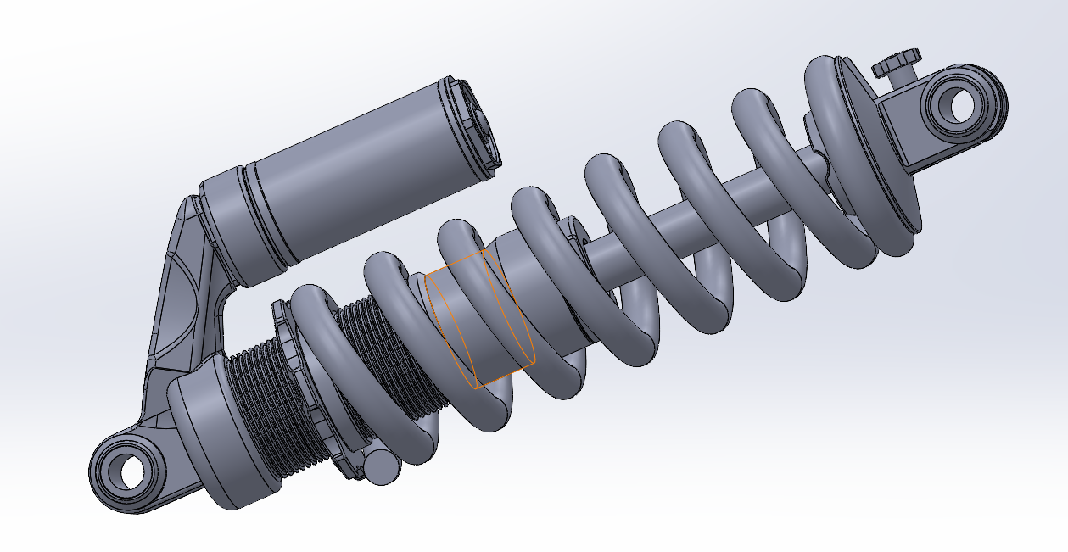
Design Description – Pushrod
LL
Figure 8. DHx2 Damper
Figure 6. Rocker Arm Version 1
Figure 7. Pushrod
Page 7 - Joe

Slide 10
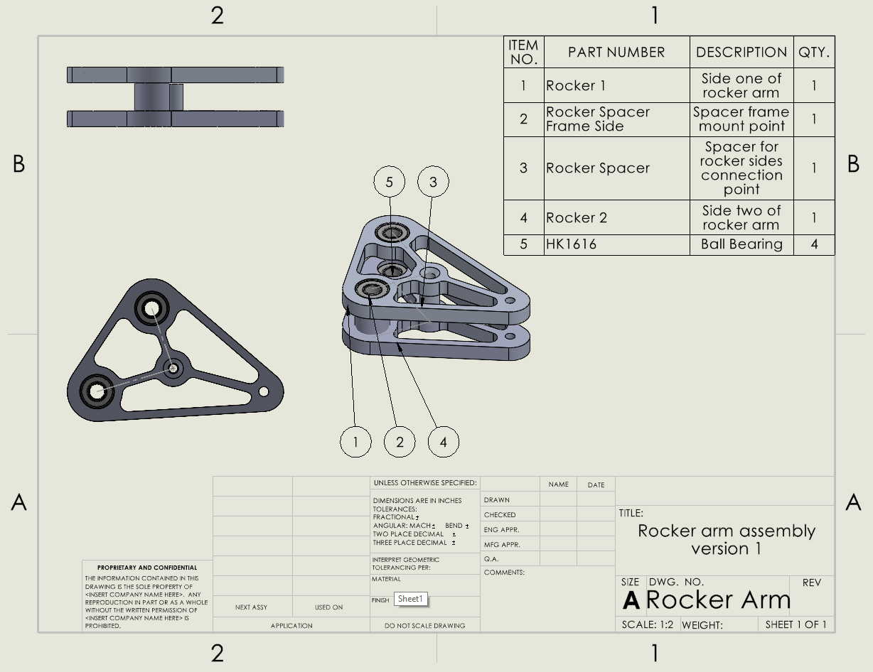
Design Description – Pushrod
Rocker arm will rotate up and down to compress or decompress springs
Rocker dimensions:
3.5 in x 2.5 in x 4.17 in
This gives a motion ration 1.5
To make Manufacuring easier rocker is all one thickness at .4 in and more material was removed to keep weight low
Rocker arm must be able to sustain 3500 N of force.
LL
Figure 9. Rocker Arm Assembly Drawing
Page 8 - Joe

Slide 11
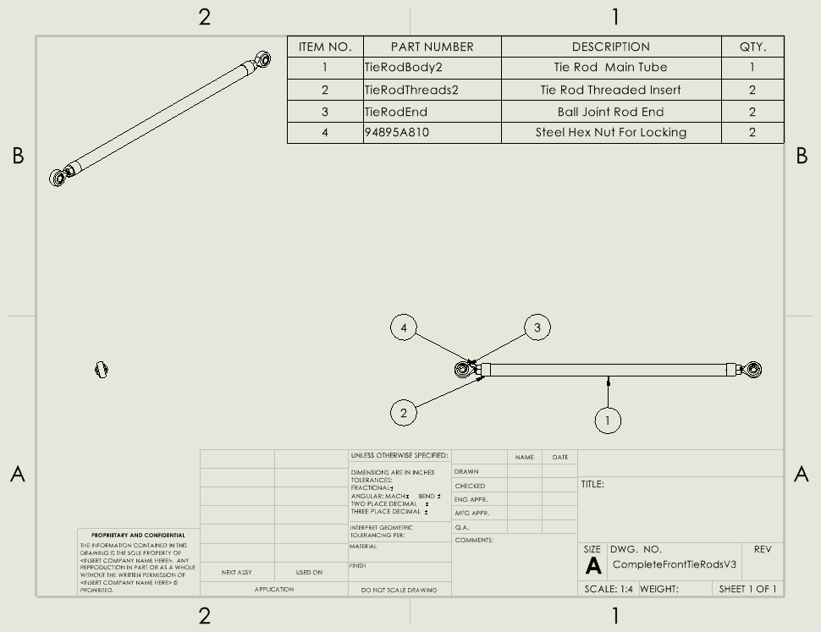
Design Description - Steering
Tie Rod system is what connects the steering rack to the knuckle
Tie rod tube hollow for weight reduction
Threaded insert to hold rod end
Rod ends for adjustability
Jam nut for locking
Operational order -
Driver turns wheel
Wheel turns steering column
Steering column turns rack
Rack moves knuckle laterally
Knuckle changes wheel angle
LL
Page 9 - Matt
Figure 10. Tie Rid Drawing

Slide 12
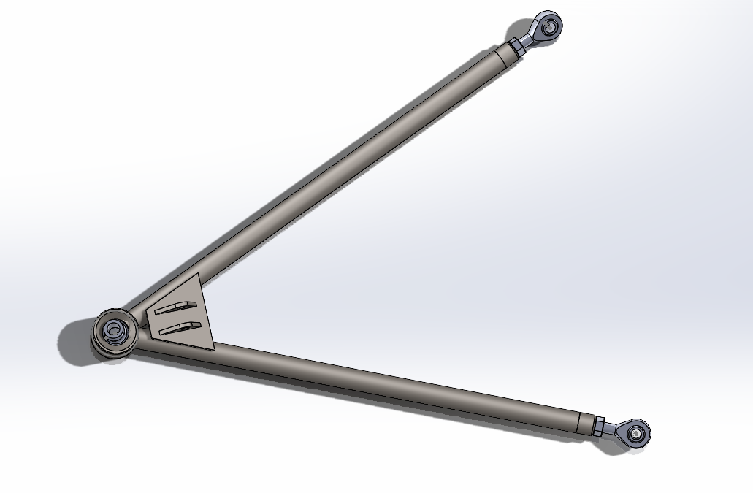
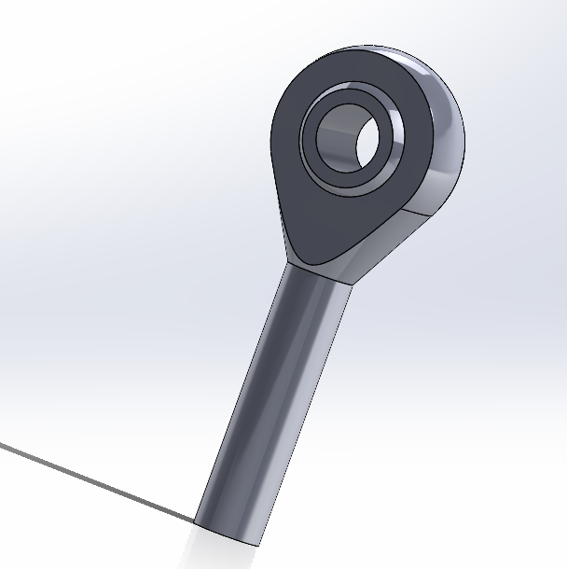
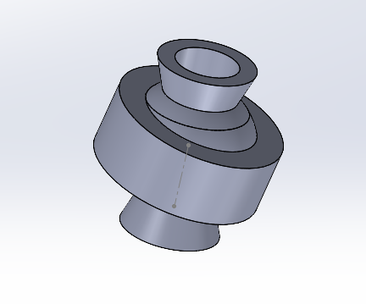
Design Description – Control Arms
LL
Figure 12. 5/16 Rod End
Figure 13. ½” Spherical Bearing
Figure 11. Front Left Lower Control Arm
Page 10 - Garrett

Slide 13
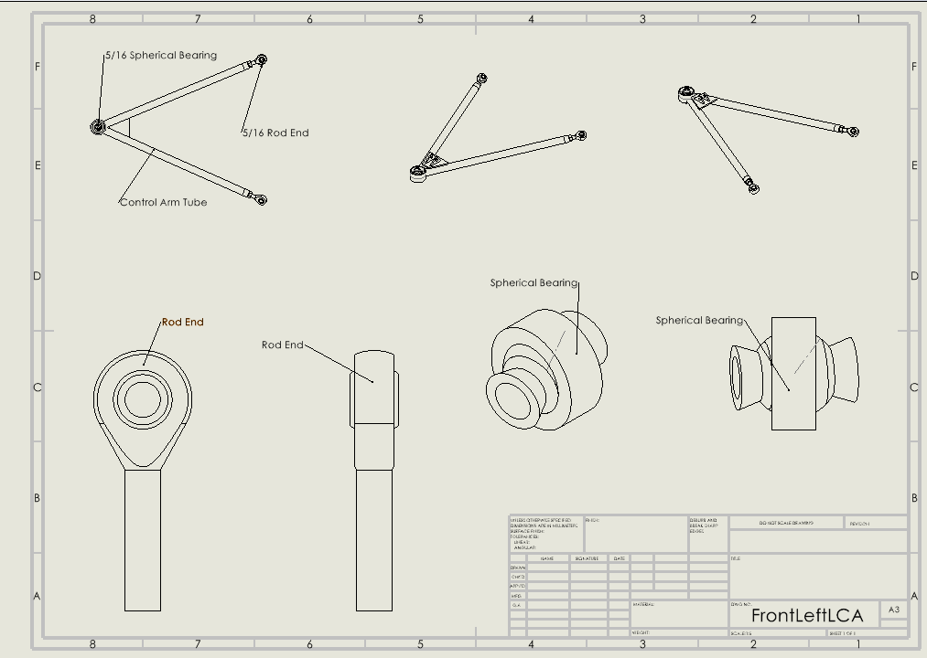
Design Description – Control Arms
LL
Page 11- Garrett
Figure 14. Control Arm Part List Drawing

Slide 14
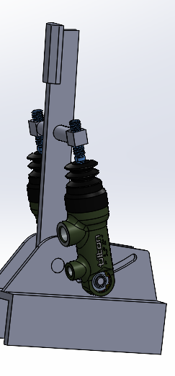
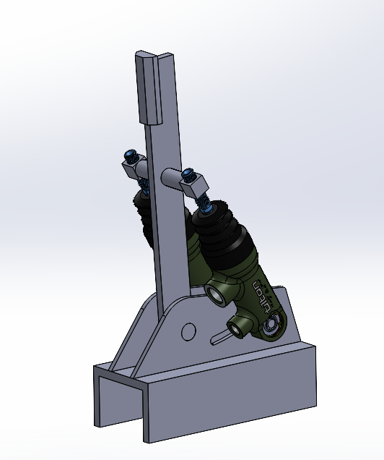
Design Description - Brakes
Design Features:
Adjustable pedal ratio
Sliding rail mount for position adjustment
Balance bar for brake bias tuning
~¾" adjustment on threads
Operation order:
Driver presses brake pedal with adequate force
Master cylinders are compressed, with a certain percentage going to the front MC and some going to the rear depending on the bias bar
Fluid is forced through the MC and then through the brake lines
Brake pads are compressed evenly on rotor
LL
Figure 15. Brake Pedal assembly
Page 12 - Chris

Slide 15
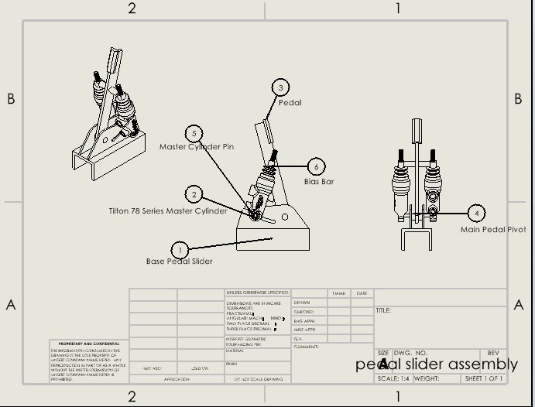
Design Description - Brakes
LL
Page 13 - Chris
Figure 16. Brake Pedal Box Drawing

Slide 16
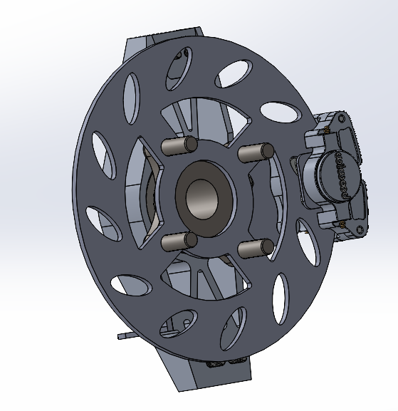
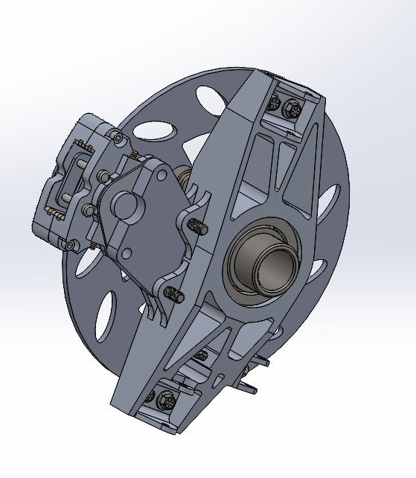
Design Description - Brakes
LL
Figure 16. Brake assembly
Page 13 - Chris

Slide 17
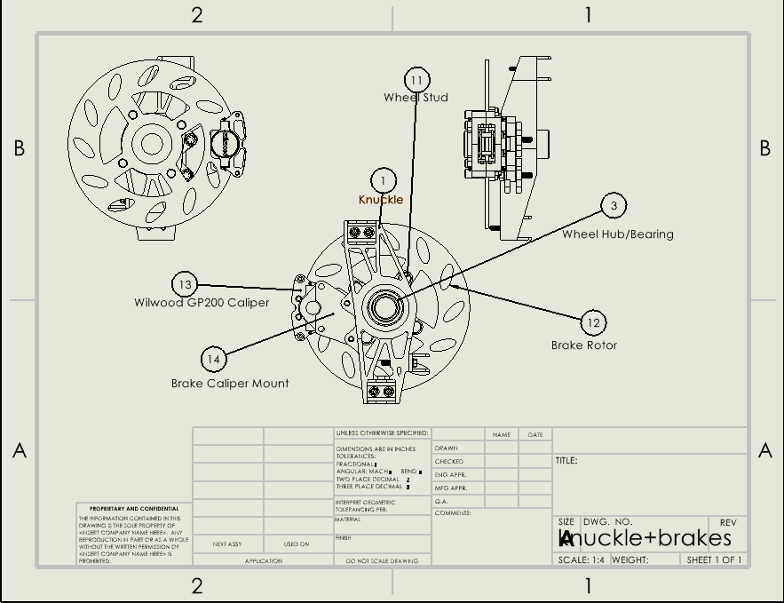
Design Description - Brakes
LL
Page 13 - Chris
Figure 16. Brake assembly Drawing

Slide 18
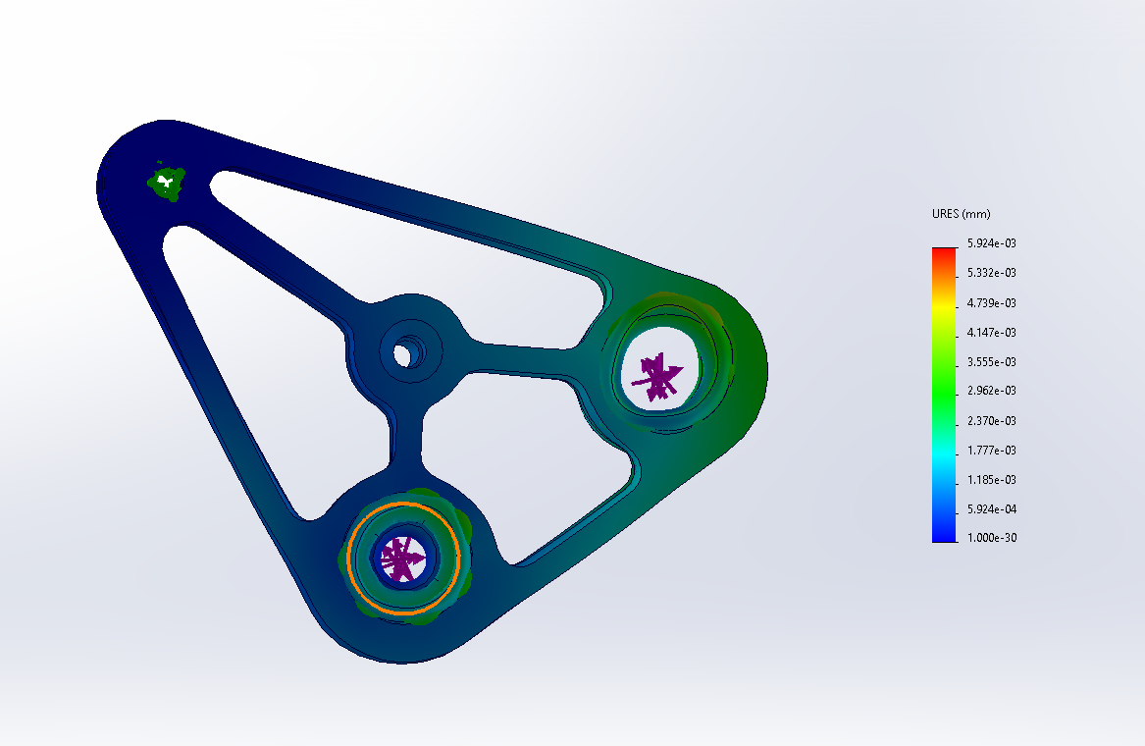
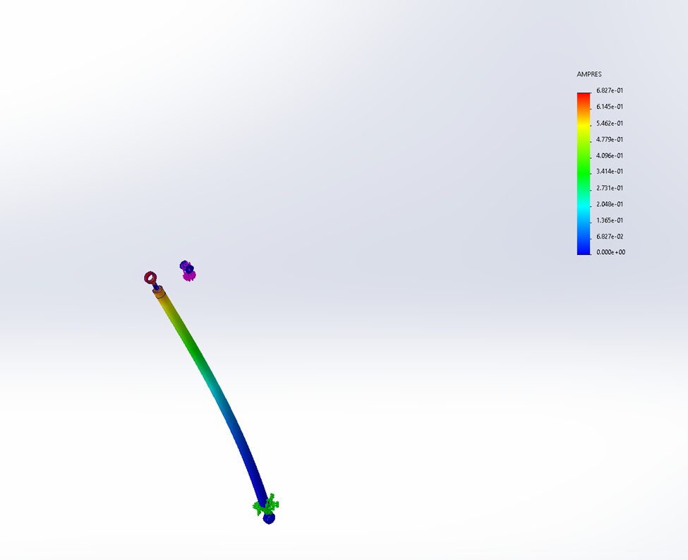
Engineering Calculations- Pushrod
I =(π(.25 in)⁴)/4= .00307 in⁴​
P_{cr}= (π²*(10*10⁶ psi ) * .00307 in⁴)/(1.0*22.1 in)²= 620.4 Ibf
Buckling Calculation:
P_{cr}=(πEI)/(KL)²
Variables:
P_{cr} = Critical Load
E = Young's modulus of pushrod material
(aluminum 10*10⁶ psi)
I = Aera moment of inertia of pushrod cross-section
L = Length of pushrod
(22.1 in*^{this will change})
K = Column effective length factor
(1.0)
LL
Figure 17. Rocker Arm Stress results
Initial Solidworks stress test showed the current design holds up well to the current max force(3500 N). Now last tests will be performed in Ansys to finalize design.
Figure 18. Pushrod stress results
Page 14 - Joe

Slide 19
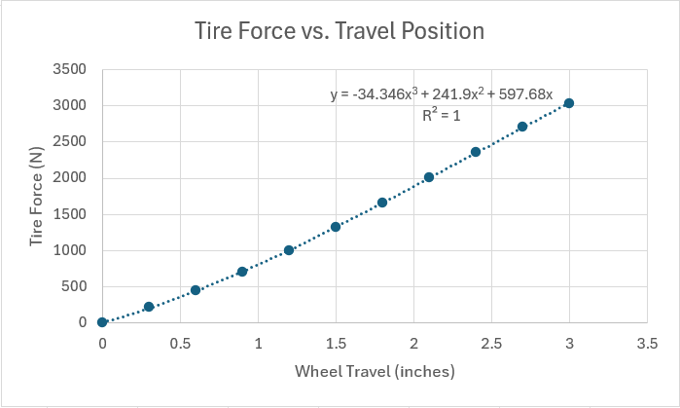
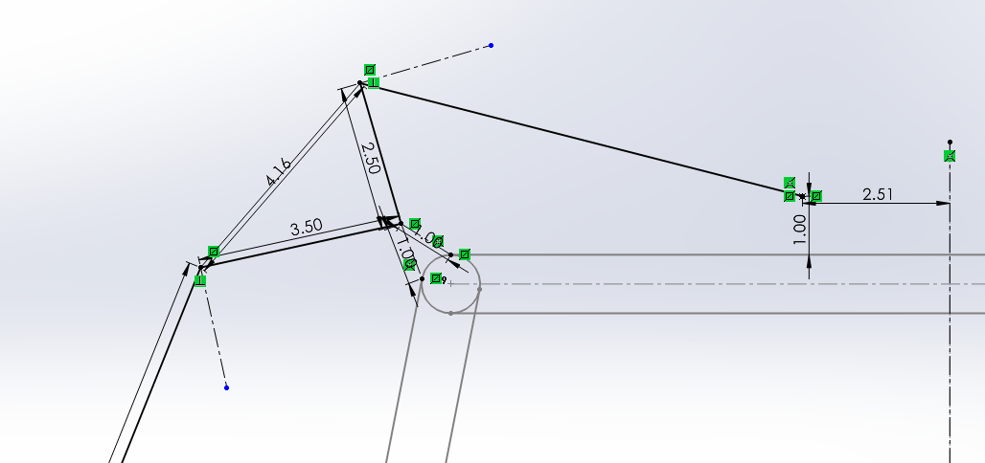
Engineering Calculations-Geometry
Created matlab code using suspension geometry in CAD to model forces in the pushrod system
Used worse case loading scenario to acquire a minimum value of 700 lbf/in spring rate
Since the loading scenario is unrealistic for application, we will try a few spring rates of 400 and 500 lbf/in
This will give us more desirable values for down travel for better handling over bumps
LL
Page 15 - Parker

Slide 20
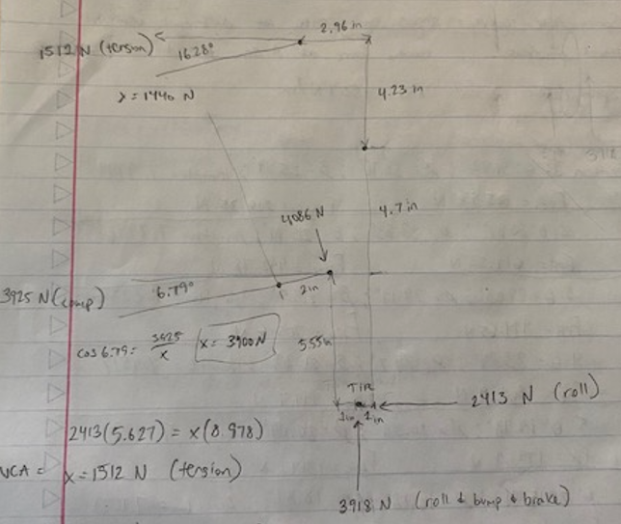
Engineering Calculations-Geometry
Used worse case scenario forces to model a FBD to determine the loads on the control arms
Values of 4000 N vertically and 2400 N horizontally were determined for the force acting on the center of tire contact patch.
1400 N (tension) for upper control arms and around 4000 N in compression for the lowers
These values will be used for ANSYS analysis on control arms and will help with ANSYS on the steering knuckles
LL
Page 16 - Parker

Slide 21
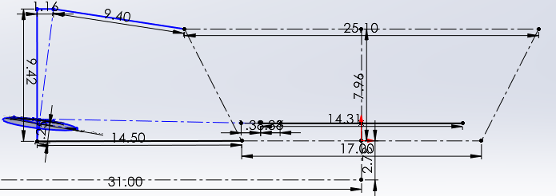
Engineering Calculations-Steering
For calculations I use base tie rod lengths
11.4 in
17.4 in
14.4 in
These are based on NARRCO steering rack length and the tie rods needed for using them
LL
Figure 19. - Steering Geometry
Values for bump and droop -
11.4: bump .85 deg droop .16 deg
14.4: bump .24 deg droop -.12 deg
17.4: bump .30 deg droop .05 deg
Values show desirable results to continue using 14.4 inch rack
Page 17 - Matt

Slide 22
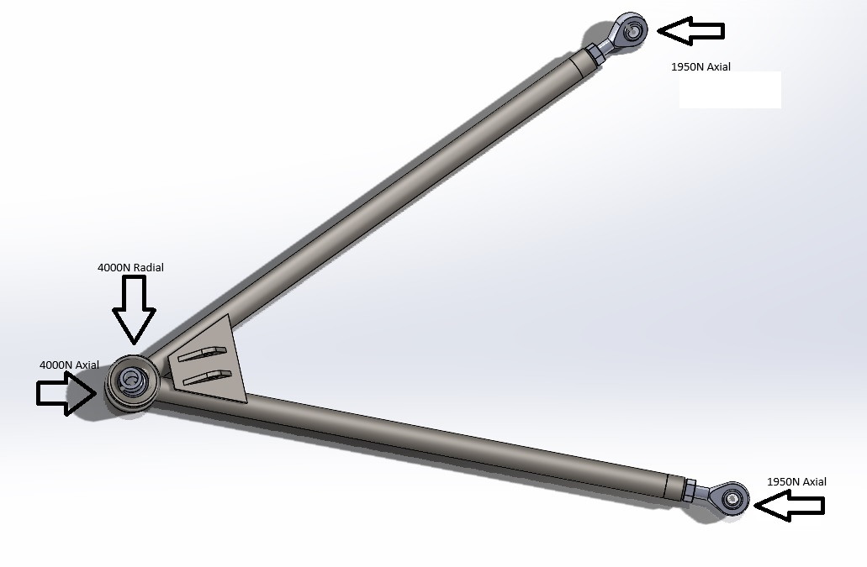
Engineering Calculations – Control Arms
LL
Figure 20. Control Arm Force
Page 18 - Garrett

Slide 23
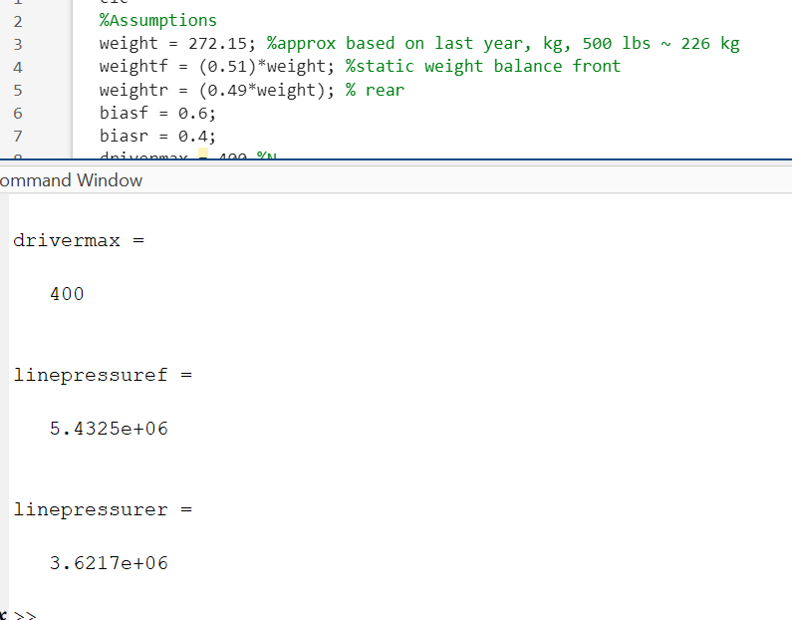
Engineering Calculations- Brakes
Calculating the Lock-Up Force(Front axle)
Dynamic on Front Axle = Mass*(Lr+h)/L = 78% percent front, 22% rear
Longitudinal load Transfer (Ft) = µ*m*h*g/L = 1399 N
Normal Force on Front Tyres (Fnf) = ((m*g*Lr)/L) +Ft = 2098 N
Lock-Up Force(Ff) = Fnf** µ/2 = 1468 N
Lock-Up Torque = Ff*R = 391 N/m
391 = (2)(0.5)(Brake Line Pressure)(piston area)(average effective radius)
Lock-Up Brake Line Pressure = 5.83 e 6 N/m^2 = ~750 psi
With 5/8" bore master cylinders front and rear, this equates to 400N input force at the pedal
LL
Figure 21. MATLAB code for brakes
Page 19 - Chris

Slide 24
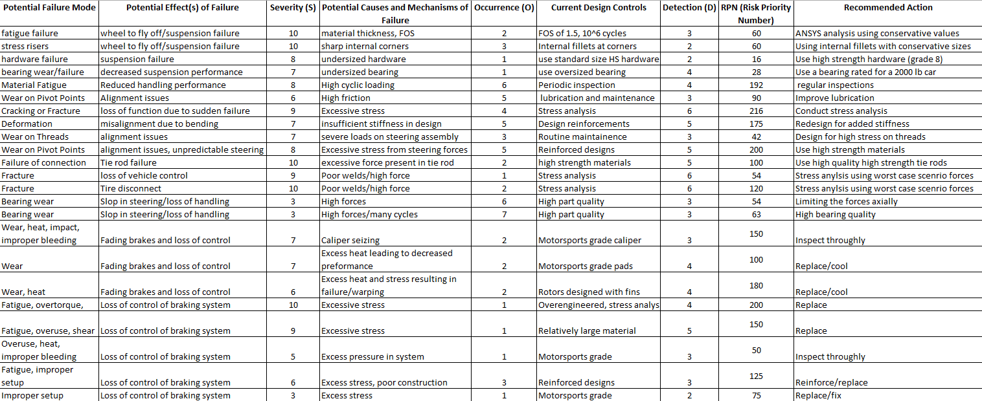
FMEA chart
LL
Page 20 - Parker

Slide 25
Testing Procedures
Our goal is to test the car several times, one of the times being on campus in the space provided to us by parking services.
All day event, consisting of several testing procedures of the vehicle handling, steering force required, braking distances, and measuring tire temps to adjust static camber.
The spring rate will also be tested and we will decide how to adjust based off handling characteristics.
Iterative testing will be done to test the heat capacities of components along with their wear rates
We will need ample space, volunteers, safety equipment, tools, replacement parts and other parts for changing geometry
We will also be doing an additional testing day will the 3 other state universities
LL
Page 21 - Parker

Slide 26
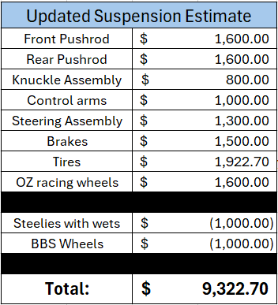
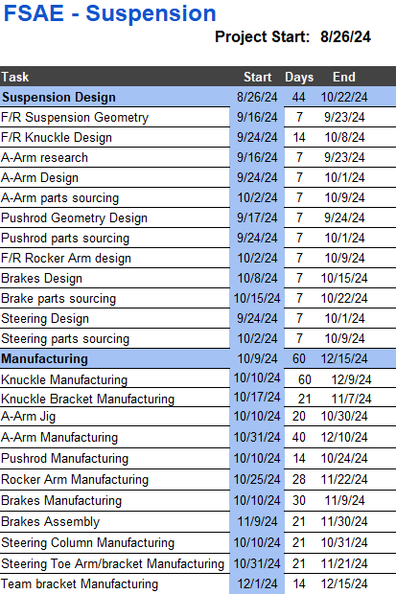
Schedule and Budget
LL
Page 22 - Parker

Slide 27
Next Steps
Do a full assembly with motion analysis, confirming our design will work as intended.
Finalize forces acting on all components, bring to ANSYS and do any necessary design adjustments.
Update full assembly and confirm parts will still work
Finalize manufacturing processes and order stock, parts, hardware and all materials
LL
Page 23 - Parker

Slide 28
Thank you!

